Slide 1
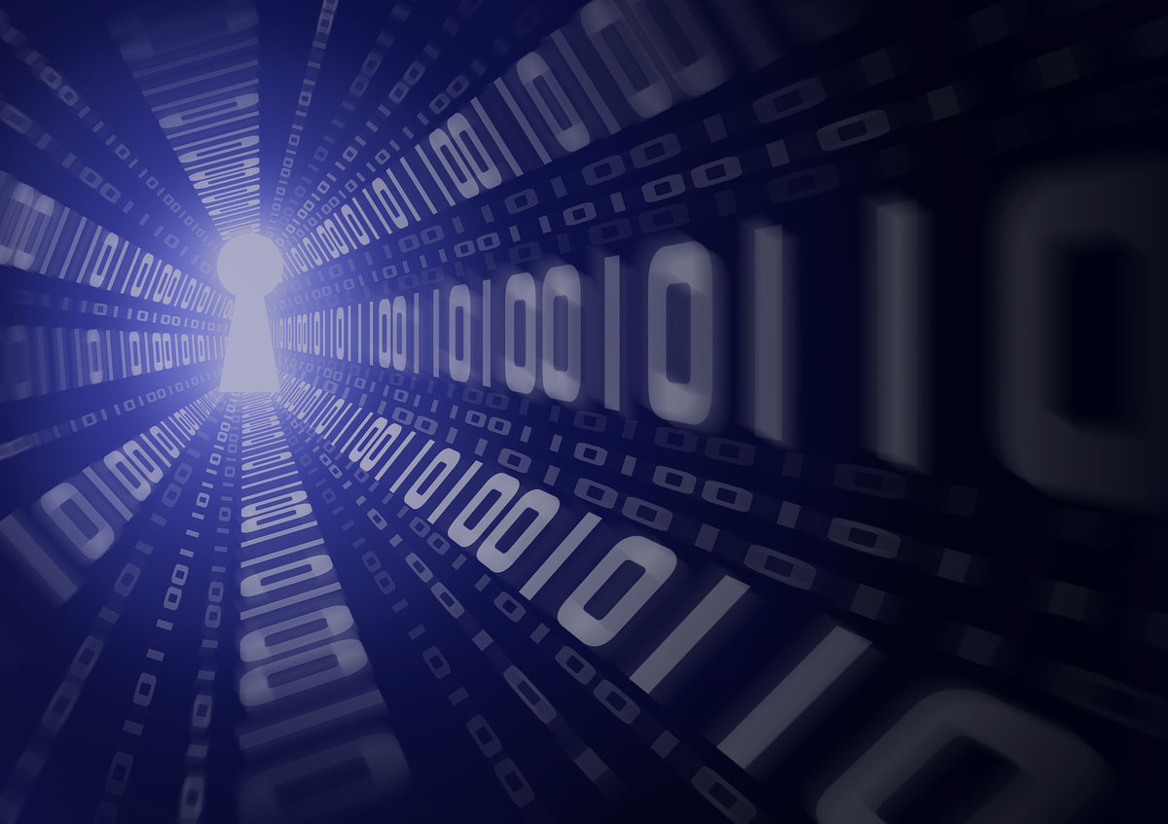
Project ID: BT2177
A REVIEW ON QUANTUM CRYPTOGRAPHY
NAME OF SUPERVISOR :S JANARTHANAN
KARANJEET SINGH 21SCSE101644
ABHINAV KUMAR CHOUDHARY 21SCSE1011615
SHIVANI KUMARI 21SCSE1011614
EBAD ZAFAR 21SCSE1011484

Slide 2
CONTENT:
INTRODUCTION
HISTORY
PRINCIPLES
MODERN CRYPTOGRAPHY
CLASSIC VS QUANTUM BITS
QUBIT REPRESENTATION
MERITS
DEMERITS
REFERENCES

Slide 3
Introduction
Quantum cryptography is a method of encryption that uses the properties of quantum mechanics to secure and transmit data so that it cannot be hacked or tracked by anyone who shouldn’t have its access .
it is highly secured model which is based on transfer of photon which is called qubit .
QKD, also called Quantum Cryptography, is a mechanism to develop secure communication . QKD is essential to address the threat that rapid advancement in Quantum Computing poses to the security of the data being transported by various critical sectors through the current communication networks.

Slide 4
History
Charles H. Bennett and Gilles Brassard revived the field in 1982 by combining quantum process with public key cryptography.
First proposed by Stephen Wiesner, then at Columbia University in New York, who, in 1968 or later, introduced the concept of quantum money and quantum conjugate coding.

Slide 5
Principle :
Quantum cryptography adapts quantum mechanical principles like Heisenberg Uncertainty principle and photon polarization principle .
It works on the principle of polarisation of data in the form of waves .

Slide 6
Quantum bits :Fundamental unit of Quantum Information
Mathematically, a qubit is a vector representing probabilities of 0 and 1 with the help of
magnitude coefficient α and β respectively which are restricted to constitute a probability of 1
i.e. α^2+ β^2=1. If α reaches to 1 then β will tend to 0.
The following equation gives an idea how a qubit works mathematically:
Qubit Q = |α|0 + |β|1
The values of coefficients depend on the complex numbers which are real numbers that makes coefficients real as well. If either α or β reaches to 1, other must be 0 . Let us imagine explain the difference between classical computers (N^2) and Quantum computers (2^n). In a puzzle, a classical computer will start the solution from start if it hits a dead end or a wall whereas in a Quantum computer, properties of qubit helps in continuing the calculation for the solution.
The Literature review on Quantum Leap explains the idea of quantum computing and what
difficulties it takes to achieve. Later the literature discusses the research in progress behind
quantum computing and its prowess.

Slide 7
Classic bits vs quantum bits:
There are two possible outcomes for the measurement of a qubit—usually taken to have the value "0" and "1", like a bit or binary digit. However, whereas the state of a bit can only be either 0 or 1, the general state of a qubit according to quantum mechanics can be a coherent superposition of both. Moreover, whereas a measurement of a classical bit would not disturb its state, a measurement of a qubit would destroy its coherence and irrevocably disturb the superposition state. It is possible to fully encode one bit in one qubit. However, a qubit can hold more information, e.g., up to two bits using superdense coding.
For a system of n components, a complete description of its state in classical physics requires only n bits, whereas in quantum physics it requires 2^{n} complex numbers (or a single point in a 2^{n}-dimensional vector space)

Slide 8
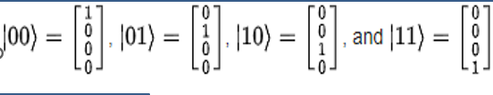
Representation of two qubits:
These two orthonormal basis states, {|0> ,|1>}, together called the computational basis, are said to span the two-dimensional linear vector (Hilbert) space of the qubit.
Qubit basis states can also be combined to form product basis states. A set of qubits taken together is called a quantum register. For example, two qubits could be represented in a four-dimensional linear vector space spanned by the following product basis states:

Slide 9
Merit :
Provides secure communication
Detects Spy
Offers multiple methods for security
Data Integrity
Authentication

Slide 10
Demerit :
Maintaining A Quantum Communication Network
Transferring Quantum States
Public Trust
Sharing Infrastructure
Changes in polarization and error rates

Slide 11
Applications :
Quantum-encrypted video call(trial early this year).
Secure voting(Switzerland since 2007).
Quantum Smart Card(Los Alamos National Lab).
Secure the network of higher official.

Slide 12
REFERENCE:
Bennett ch quantum cryptography:letter 1992,68(21):3121-24
A review on quantum cryptography –research gate
iEEE journal on quantum cryptography
www.quantlr.com

Slide 13
THANK YOU

